Slide 1
Writing Linear Equations from Situations, Graphs, & Tables
Essential Question?
How do you write an equation to model a linear relationship given a graph, a table, or a description?
8.F.4

Slide 2
Common Core Standard:
8.F.4 ─ Use functions to model relationships between quantities.
Construct a function to model a linear relationship between two quantities. Determine the rate of change and initial value of the function from a description of a relationship or from two (x, y) values, including reading these from a table or from a graph. Interpret the rate of change and initial value of a linear function in terms of the situation it models, and in terms of its graph or a table of values.

Slide 3
Objectives:
To write a linear equation which models a word problem, a table, or a graph.

Slide 4
Slope-Intercept Form http://stevensonalgebra.weebly.com/algebra-songs.html

Slide 5
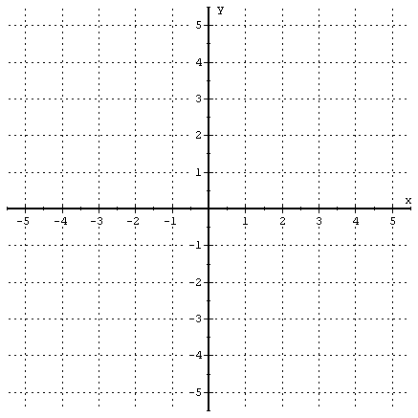
Writing an Equation from a Graph
Write a linear equation based on the following graph:
Step 1: Identify the y-intercept
$$\left(0,−1\right) b=−1$$
Step 2: Find the slope
$$m=+\frac{3}{2}$$
Step 3: Write the form
$$y=mx+b$$
Step 4: Replace $m$ and $b$ with the values you found and simplify
$$y=\frac{3}{2}x+\left(−1\right)$$
$$y=\frac{3}{2}x−1$$

Slide 6
Writing an Equation from a Description
Write a linear equation based on the following situation:
The rent charged for space in an office building is a linear relationship related to the size of the space rented. Write an equation in slope-intercept form for the rent at West Main Street Office Rentals.
West Main Street Office Rentals
Monthly Rates:
600 square feet for $750
900 square feet for $1150
Step 1: Create a table or identify ordered pairs from the problem
$$\left(600, 750\right) and (900, 1150)$$
Step 2: Find the slope using the slope formula (or with the table)
$$m=\frac{y_{2}−y_{1}}{x_{2}−x_{1}}=\frac{1150−750}{900−600}=\frac{400}{300}=\frac{4}{3}$$
Step 3: Write the form $y=mx+b$

Slide 7
Writing an Equation from a Description
West Main Street Office Rentals
Monthly Rates:
600 square feet for $750
900 square feet for $1150
Step 4: Replace $m$ with the value you found
$$y=\frac{4}{3}x+b$$
Step 5: Plug in one of the points you already know and solve for $b$ using inverse operations
$$\left(600, 750\right) or (900, 1150)$$
$$750=\frac{4}{3}\left(600\right)+b$$
$$750=4\left(200\right)+b$$
$$750=800+b$$
$−800=−800$
$−50=b$

Slide 8
Writing an Equation from a Description
West Main Street Office Rentals
Monthly Rates:
600 square feet for $750
900 square feet for $1150
Step 6: Write the form
$$y=mx+b$$
Step 7: Replace $m$ and $b$ with the values you found and simplify
$$y=\frac{4}{3}x+(−50)$$
$$y=\frac{4}{3}x−50$$

Slide 9
Writing an Equation from a Table
The table below shows the temperature of a fish tank during an experiment. Write a linear equation in slope-intercept form that represents this situation.
Time (h) | 2 | 3 | 4 | 5 | 6 | 7
Temperature (°F) | 78 | 76 | 74 | 72 | 70 | 68
Step 1: Find the slope (either the jumps or the slope formula)
$$m=\frac{y_{2}−y_{1}}{x_{2}−x_{1}}=\frac{70−72}{6−5}=\frac{−2}{1}=−2$$
Step 2: Follow steps 4 ─ 7 from the previous procedure
-or-
Use Point-Slope Form
$$y−y_{1}=m\left(x−x_{1}\right)$$

Slide 10
Point-Slope Form http://stevensonalgebra.weebly.com/algebra-songs.html

Slide 11
Using Point-Slope Form
Step 1: Choose one of the known points and label it
$$\left(5, 72\right) or \left(6, 70\right)$$
I chose $\left(6, 70\right)$
$\left(x_{1}, y_{1}\right)$
Step 2: Plug the slope $m$, $x_{1}, and y_{1}$ in to the Point-Slope Form and re-write in Slope-Intercept form
$$y−y_{1}=m\left(x−x_{1}\right)$$
$$y−70=−2\left(x−6\right)$$
$$y−70=−2x+12$$
$+70=+70$
$y=−2x+82$

Slide 12
Try This One
Stephanie’s weekly allowance varies depending on how many chores she does. Last week she did 12 chores and received $16. This week she did 8 chores and received $14. Write an equation in Slope-Intercept Form to describe her allowance.

Slide 13
Try This One
The following table shows the volume of water released by the Hoover Dam over a certain period of time. Graph the data, find the slope and y-intercept, then write the equation for the graph in slope-intercept form.
Water Released from the Hoover Dam
Time (s) | Volume of Water (m³)
5 | 75,000
10 | 150,000
15 | 225,000
20 | 300,000

