Slide 1
Distance Between Two Points
Essential Question?
How can you use the Pythagorean Theorem to find the distance between two points on a coordinate plane?
8.G.8

Slide 2
Common Core Standard:
8.G ─ Understand and apply the Pythagorean Theorem.
8. Apply the Pythagorean Theorem to find the distance between two points in a coordinate system

Slide 3
Objectives:
To use the Pythagorean Theorem to find the distance between two points on a coordinate plane.

Slide 4
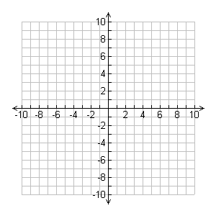
The Pythagorean Theorem in the Coordinate Plane
Determine the length of the line segment to the nearest tenth using a calculator.
STEP 1:
Use the grid lines to draw a right triangle
STEP 2:
Determine the length of the legs of the right triangle
STEP 3:
Use the Pythagorean Theorem to find the missing side
$$4^{2}+2^{2}=c^{2}$$
$$16+4=c^{2}$$
$$20=c^{2}$$
4 units
2 units
$$\sqrt{20}=\sqrt{c^{2}}$$
$$4.5≈c$$
The length of the line segment is approximately 4.5 units.

Slide 5
The Pythagorean Theorem in the Coordinate Plane
Approximate the length of the line segment to the nearest tenth using a calculator.

Slide 6
The DISTANCE FORMULA
The Pythagorean Theorem can be used to find the distance between any two points $\left(x_{1},y_{1}\right)$ and $\left(x_{2},y_{2}\right)$ in the coordinate plane.
We can think of the distance between the two points as the hypotenuse of the right triangle.
Now draw the right triangle.
The length of the vertical leg is the difference of the y-values.
$${leg}_{1}=\left(y_{2}−y_{1}\right)$$
The length of the horizontal leg is the difference of the x-values.
$${leg}_{2}=\left(x_{2}−x_{1}\right)$$
$$\left(x_{1},y_{1}\right)$$
$$\left(x_{2},y_{2}\right)$$

Slide 7
The DISTANCE FORMULA
The distance $d$ between the two points is the hypotenuse.
$${\text{distance}}^{2}={{leg}_{1}^{}}^{2}+{{leg}_{2}^{}}^{2}$$
$$d^{2}={\left(y_{2}−y_{1}\right)}^{2}+{\left(x_{2}−x_{1}\right)}^{2}$$
$$\sqrt{d^{2}}=\sqrt{{\left(y_{2}−y_{1}\right)}^{2}+{\left(x_{2}−x_{1}\right)}^{2}}$$
$$d=\sqrt{{\left(y_{2}−y_{1}\right)}^{2}+{\left(x_{2}−x_{1}\right)}^{2}}$$
$$\left(x_{1},y_{1}\right)$$
$$\left(x_{2},y_{2}\right)$$

Slide 8
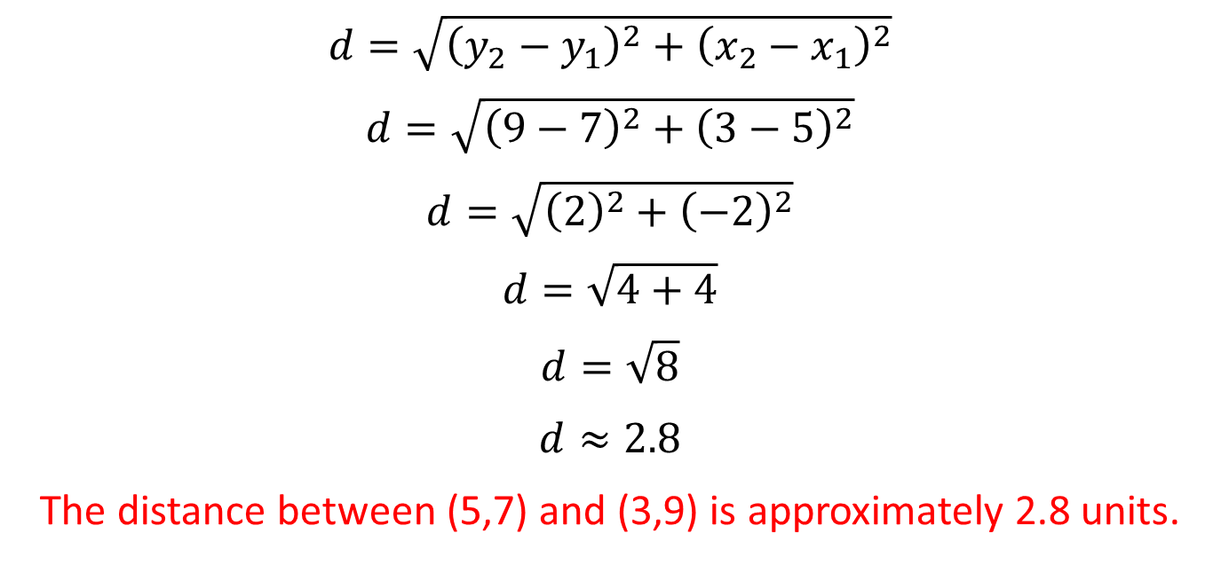
Using the Distance Formula
$$d=\sqrt{{\left(y_{2}−y_{1}\right)}^{2}+{\left(x_{2}−x_{1}\right)}^{2}}$$
Use a calculator to find the distance between the following points:
$\left(5,7\right)$and $\left(3,9\right)$
$$d=\sqrt{{\left(y_{2}−y_{1}\right)}^{2}+{\left(x_{2}−x_{1}\right)}^{2}}$$
$$d=\sqrt{{\left(9−7\right)}^{2}+{\left(3−5\right)}^{2}}$$
$$d=\sqrt{{\left(2\right)}^{2}+{\left(−2\right)}^{2}}$$
$$d=\sqrt{4+4}$$
$$d=\sqrt{8}$$
$$d≈2.8$$
The distance between (5,7) and (3,9) is approximately 2.8 units.

Slide 9
Using the Distance Formula
A plane leaves an airport and flies due north at 280 miles per hour. At the same time, another plane takes off from the same airport and flies due east at a speed of 300 miles per hour. What is the distance between the two planes after 1 hour?

Slide 10
Use the information provided to find the approximate distance between Los Angles and Las Vegas. Each unit on the graph represents 20 miles.

