Slide 1
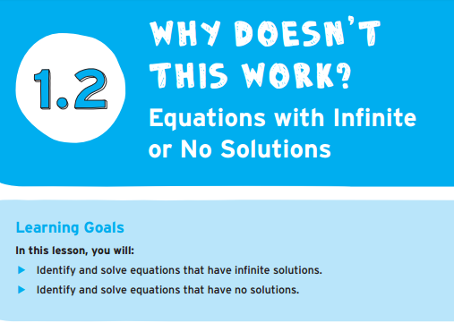
Chapter 1.2
Page 13

Slide 2
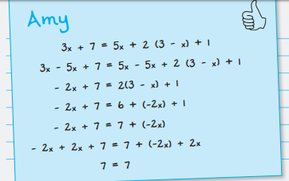
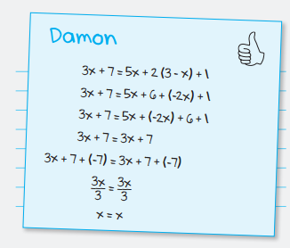
Page 14- What is the same? What is different?
What does the final part of this equation mean?

Slide 3
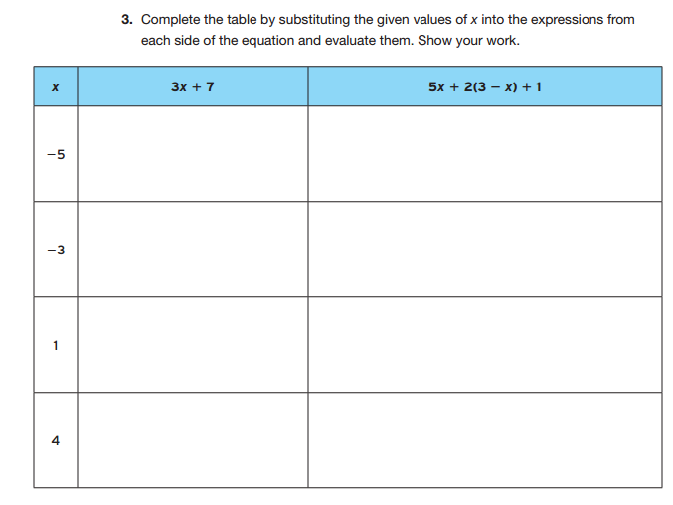
Are these equations the same?-page 15

Slide 4
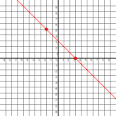
Let’s try them on desmos.com

Slide 5
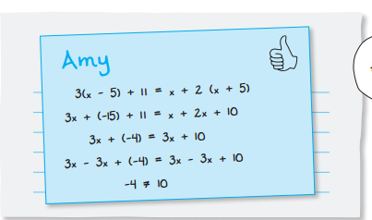
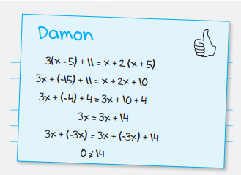
Are these the same?-page 19
What does the final part of this equation mean?

Slide 6
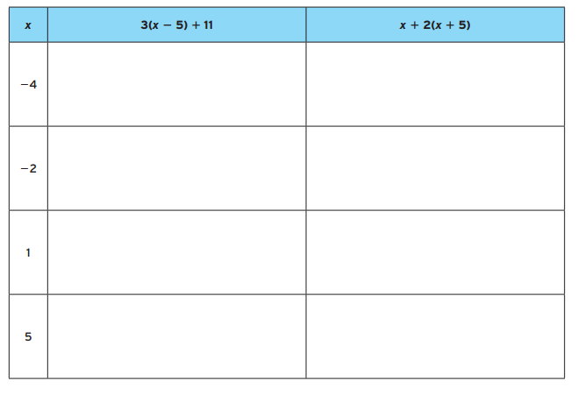
Let’s try some! Are they equal? How do we know? Page 20

Slide 7
Let’s try them again on desmos.com

Slide 8
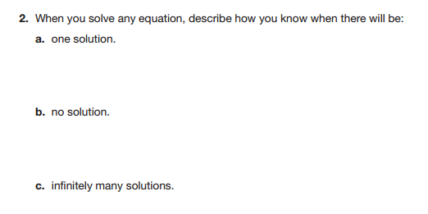
So, what do we know now?-page 23

