Slide 1
Page 3
What do you already know about these learning goals?

Slide 2
The World’s Oldest Equations--page 3

Slide 3
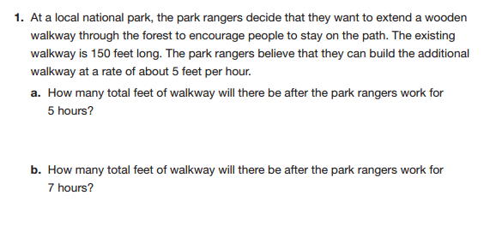
Solving a problem from a situation...page 4

Slide 4
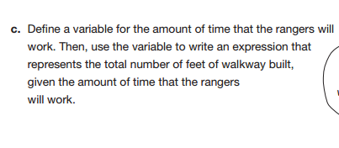
Solving a problem by writing an equation...page 4

Slide 5
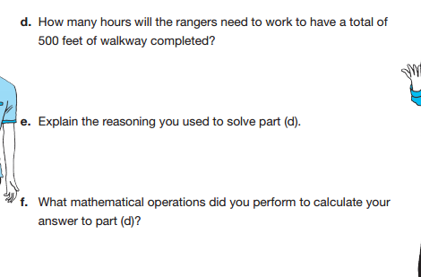
Which one will you use to solve these?--page 4

Slide 6
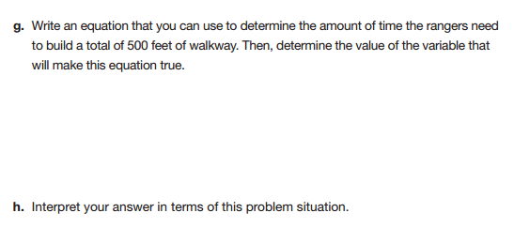
Use an equation to solve and what does your answer mean?--page 5

Slide 7
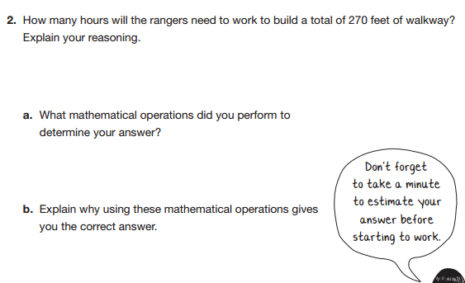
Use an equation again?--
page 5

Slide 8
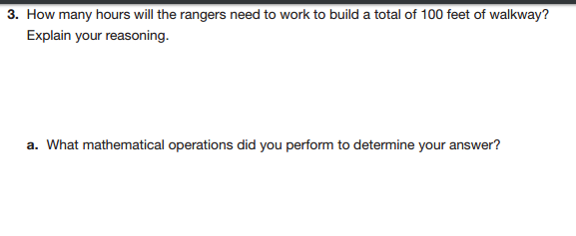
Solve the situation...page 6

Slide 9
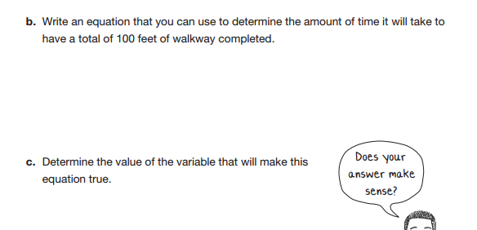
Write an equation...page 6

Slide 10
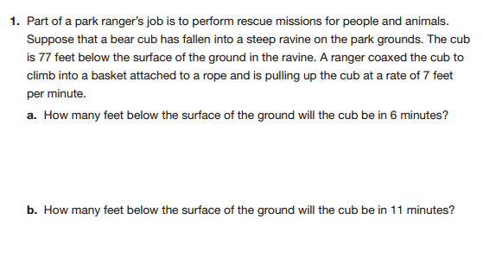
Solve the situation...page 7

Slide 11
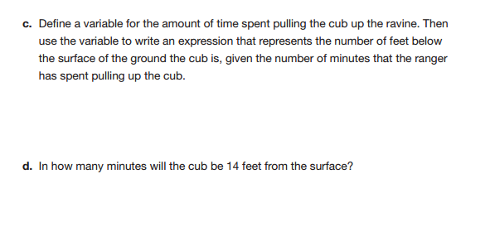
Write an equation and solve...page 7

Slide 12
How can we use the expression to help us solve this? Page 9

Slide 13
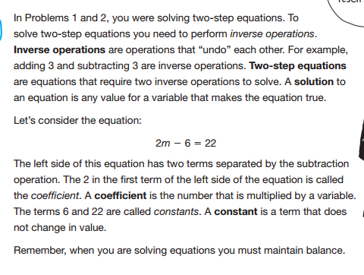
Solving a two step equation...page 9

Slide 14
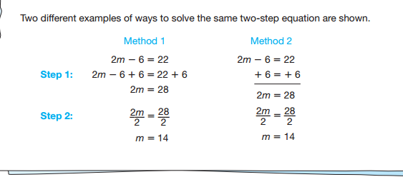
Solving a two step equation--two examples
page 10--what is the difference in these two?

