Slide 1
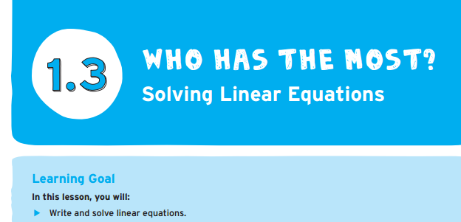
What have we already done to complete this learning goal?
Page 25

Slide 2
Solving Linear equations Page 26

Slide 3
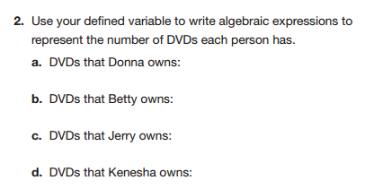
Solving Linear equations Page 26

Slide 4
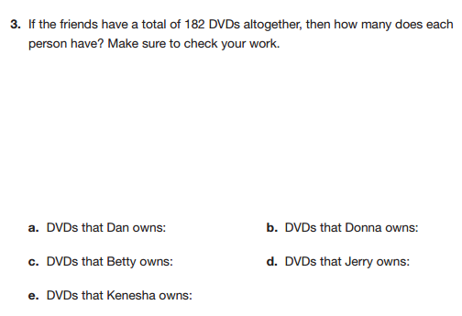
Page 26-How can we use our expressions to help us solve?

Slide 5
Pick one of these problems and solve it with your group:
These are not in your book!

Slide 7
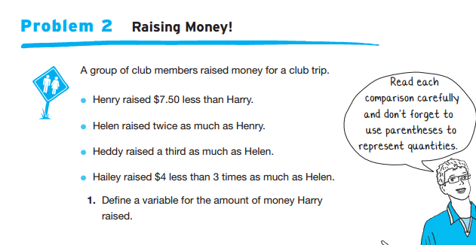
Solving Linear equations

Slide 8
